Slide 1
Machine Learning and its applications

Slide 2
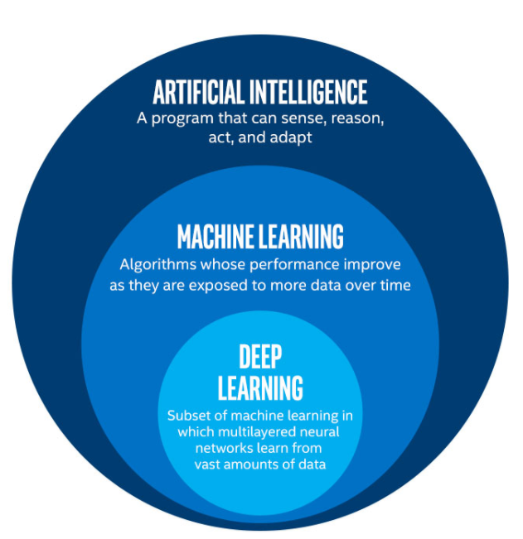
AI is a bigger concept to create intelligent machines that can simulate human thinking capability and behavior, whereas, machine learning is an application or subset of AI that allows machines to learn from data without being programmed explicitly.

Slide 3
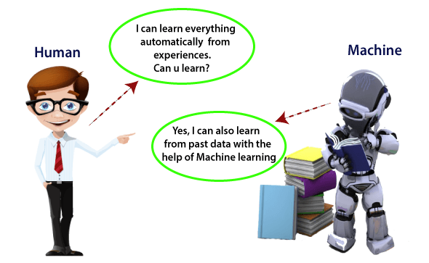
Machine Learning(ML)
Computers learn automatically from past data.
Uses Various algorithms for building mathematical models and making predictions using historical information.

Slide 4
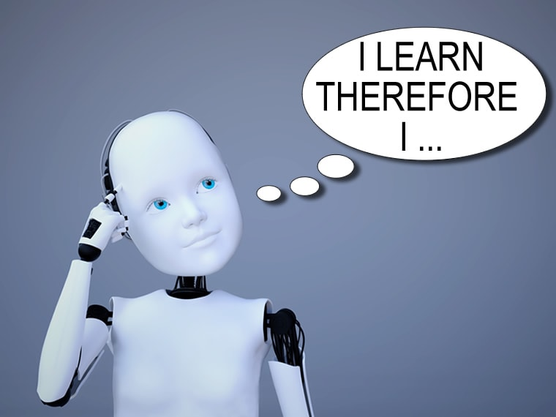
Why do we need machine learning?
It is capable of doing tasks that are too complex for a person to implement directly.
As a human, we have some limitations as we cannot access the huge amount of data manually.
We can train machine learning algorithms by providing them the huge amount of data and let them explore the data, construct the models, and predict the required output automatically and efficiently.
Rapid increment in the production of data.
Solving complex problems, which are difficult for a human
Decision making in almost all sector.
Finding hidden patterns and extracting useful information from data.

Slide 5

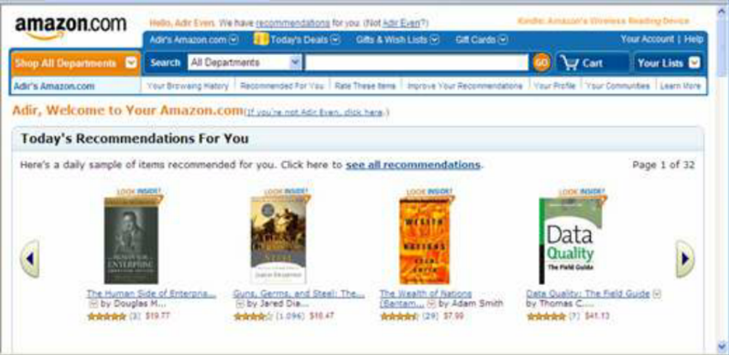
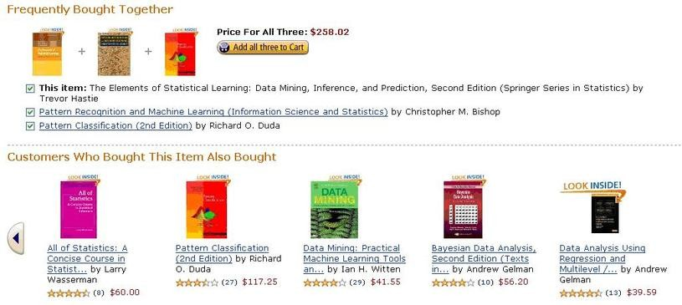
Amazon has built machine learning models that are using a vast amount of data to analyze the user interest and recommend product accordingly.

Slide 6
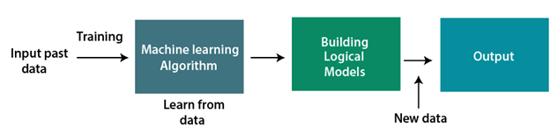
How does machine learning works?
A Machine Learning system learns from historical data, builds the prediction models, and whenever it receives new data, predicts the output for it.
With the help of sample historical data, which is known as training data, machine learning algorithms build a mathematical model that helps in making predictions or decisions without being explicitly programmed.

Slide 7
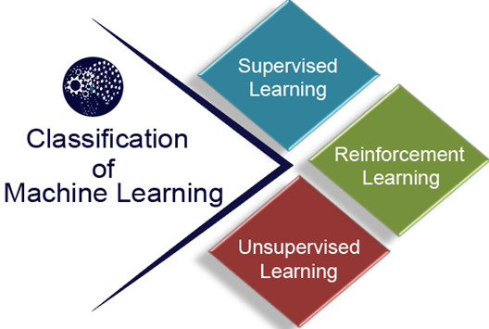
Classification of Machine Learning

Slide 8
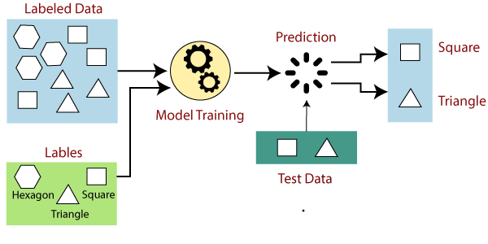
Supervised learning
Labeled data samples are provided the machine learning system inorder to train it, and on that basis it predicts the output.
Goal is to map input data with output data
TWO CATEGORIES OF ALGORITHMS:
Classification
Regression
Classification: Is it a cat or dog?
Regression: How much the house will sell for?

Slide 9
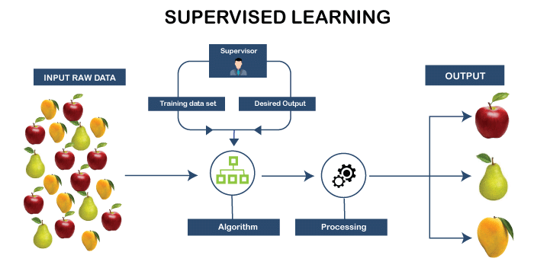

Slide 10
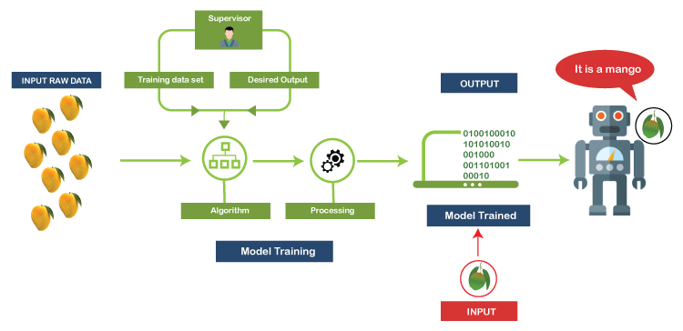

Slide 11
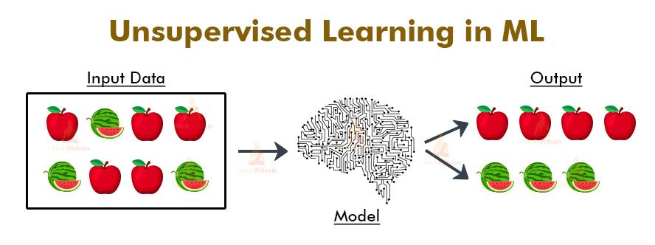
Unsupervised Learning
-No labelled data for learning.
-Training happened only through data without any supervision
TWO CATEGORIES OF ALGORITHMS:
Association
Clustering
It is best used if you want to find patterns but don’t know exactly what you’re looking for.
Association: How many people buy milk also buy butter?
Clustering: Which group of customer will drop the services?

Slide 12
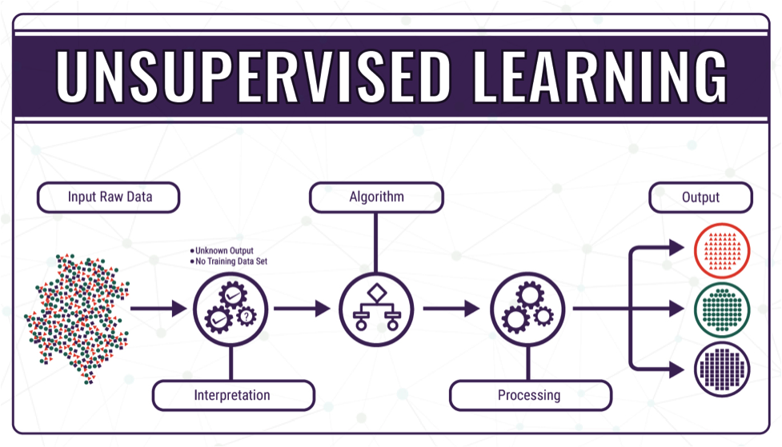
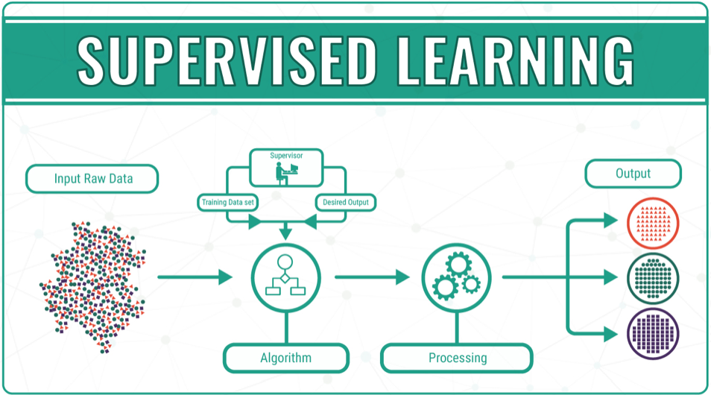
Supervised Vs. Unsupervised

Slide 13
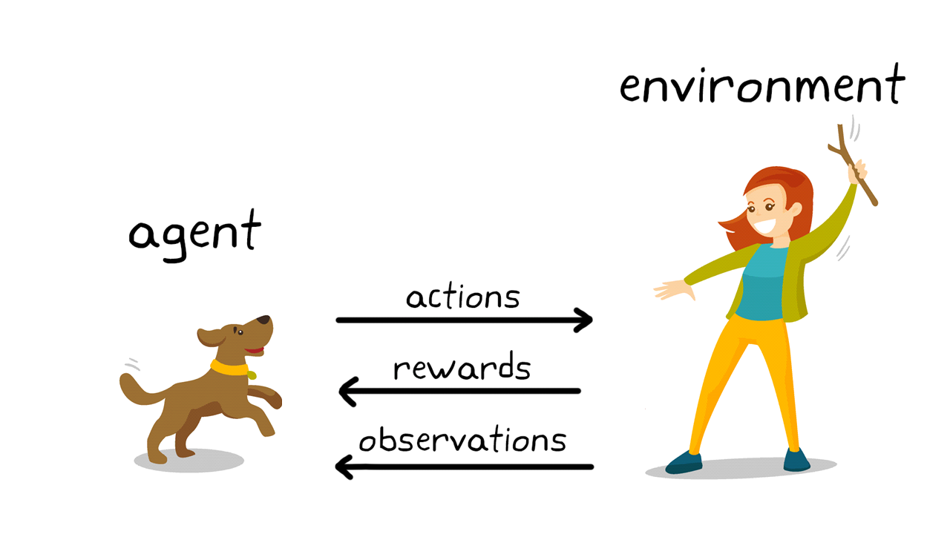
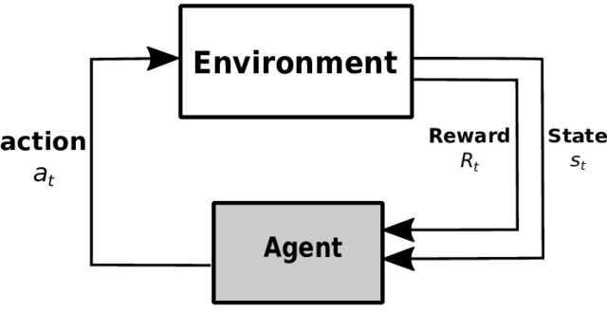
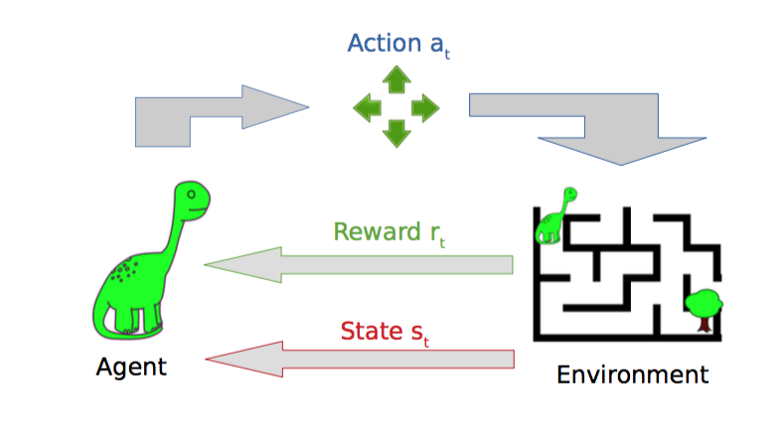
Reinforced Learning
Reinforcement learning is a feedback-based learning method, in which a learning agent gets a reward for each right action after interacting with its environment, and automatically learns from this feedback and improves its performance.
Solves higher order & complex problems.

Slide 14
Machine Learning Case Study
TESLA-well known for advanced & futuristic cars in Electric Automobile industry
It has AI hardware for Self driving cars
Car is equipped to transfer drivers seating position, traffic in the area and other valuable information, through input-output sensors to tesla’s cloud(ML Server). This data is used for making highly detailed maps for navigation. Cloud holds all its cars data.ML can train all vehicles to go according to the map. Other advanced computing techniques(EDGE) are used to decide the cars action and other movements.

Slide 15
Real AI&ML applications in use today
Face detection and Recognition Technology
Text Editors
Social Media(Friends suggestion in facebook)
Chatbots(ML enabled personal customer support)
Recommendation Systems(automatic notifications)
Search algorithms
Personal Digital Assistants
Smart Home Devices

Slide 16
ML applications in healthcare
Disease Identification and diagnosis
Drug discovery and Manufacturing
Personalized medicine
ML based behavioral modifications
Smart Health Records
Crowdsource Data Collection
Outbreak Prediction
Enhanced disease diagnosis owing to better accuracy and improved patient experience
Low operational cost and manpower due to automation

Slide 17
ML applications in finance
Financial Monitoring and Advisory
Investment Predictions
Secure transactions
Risk Management
Algorithmic Trading
Customer Data management, Retention etc.
Decision making and marketing
Enhanced revenues owing to better productivity and improved user experience
Low operational costs due to process automation
Reinforced security and better compliance

Slide 18
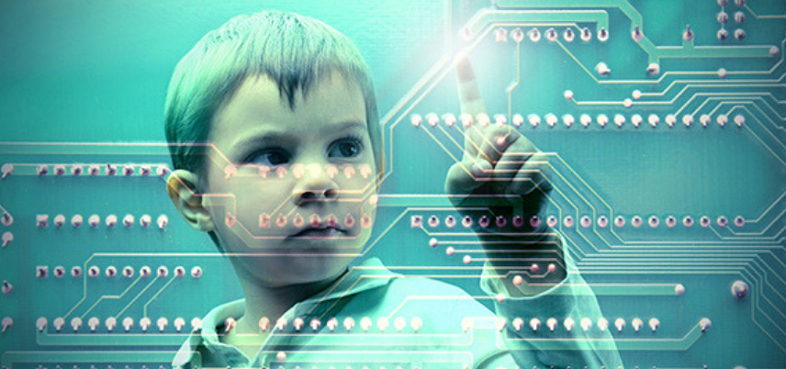
ML applications in education
Artificial Instructors and intelligent tutors
Digital student engagement programmes
Explaining subjects using AR/VR techniques.
Intelligent student data recording and analysis
Drop out and result predictions
Online assessment and personalized learning experiences.

Slide 19
ML applications in Travel & Hospitality Industry-Tourism
Intelligent Travel Assistants, Customer Supports
Flights and accommodation forecasting
Recommendation engines and travel preferences
Fraud detection and Prediction
Automatic messaging
Check in-out through FaceIDs
Hygiene System using Robots

Slide 20
ML applications in Communication Sector
Speech and Voice Service for customers.
Customer service chatbots
Predictive maintenance

Slide 21
Q&A

